Slide 1

Refactoring
Henry Tang
hktang@ualberta.ca
Department of Computing Science
University of Alberta
CMPUT 301 – Introduction to Software Engineering
Slides adapted from Dr. Hazel Campbell, Dr. Ken Wong, and Dr. Abram Hindle
Updated by Michelle Deng 2026
Images reproduced in these slides have been included under section 29 of the Copyright Act, as fair dealing for research, private study, criticism, or review. Further distribution or uses may infringe copyright.

Slide 2
Table of Contents
Introduction
Refactoring Principles
Code Smells
Refactoring Example
More Information

Slide 3
Introduction

Slide 4
Finding Solutions…
Commonly occurring solution to a recurring problem
A solution to a problem that has negative consequences
Pattern
Anti-pattern
  Easier to recognize what is wrong (and try to fix it), than to get it “right” in the first place
Notes:
much of software engineering is about positive and constructive solutions
rather than designing it right in the first place (hard to do)
- easier to recognize what is wrong (and try to fix it)
project stories with de-moralized developers
IBM workstation compiler (poor C++)
Scriptease project (poor design over the years)

Slide 5
Exercise
What are some indicators or examples of poorly written code?
Notes:
code inspections
things that might be raised in a code review or during pair programming
being too clever
inconsistent software APIs

Slide 6
Bad Code Examples
Spaghetti code:
  Code with very complex, tangled control flow typified by lots of go-tos
Dead code:
  Code whose “result” is no longer used
Notes:
as opposed to ravioli code
object-oriented, loosely coupled components
dead code
feature experiments
result not used, but has a side effect that makes the code risky to remove
code that is not executed is truly dead

Slide 7
Refactoring
Idea:
  Change a software system so that the external behavior does not change but the internal structure is improved
  Do this in small steps (change a bit and re-test)
  When adding a feature, refactor to make the addition easier to achieve
Notes:
from the agile methods community
- extreme programming and test-driven development
example of perfective changes
need good, fast unit tests

Slide 8
Refactoring Principles

Slide 9
Refactoring
Basic principles:
  Catalog of refactorings
  Do not change outward behavior
  Reduce risk of change
  One thing at a time
  Test each step
  Iterate

Slide 10
Refactoring
Outcomes:
  Encode design intent within class structure
  Reorganizing code
  Sharing logic
  Express conditional logic
Notes:
sharing logic in superclasses
conditional logic through polymorphism

Slide 11
Refactoring
Potential limitations:
  Too much indirection
  Performance impact
  Changing published interfaces
  Are significant design changes possible?

Slide 12
Refactoring
When not to refactor:
  When you should rewrite
  When you are close to a deadline

Slide 13
Refactoring
An analogy:
  Unfinished refactoring is like going into debt
  Debt is fine if you can meet the interest payments (extra maintenance costs)
  If there is too much debt, you will be overwhelmed
  —Ward Cunningham

Slide 14
Redesigning with Patterns
Common causes of change in client code:
  Creating an object by naming the class directly
    Fix with Abstract Factory or Factory Method
  Dependence on specific hard-code requests
    Fix with Chain of Responsibility or Command
  Algorithmic dependencies
    Fix with Template Method
  Tight coupling
    Fix with Façade or Observer
  Too much subclassing
    Fix with Decorator
Notes:
creating
Abstract Factory or Factory Method
hard coded
Command
algorithmic
Template Method
tight coupling
Façade
too much subclass
- Decorator

Slide 15
Kinds of Refactorings
Creating methods:
  Intended to help reduce the size of methods and improve the readability of the code
  Extract Method, Inline Method, Replace Temp with Query

Slide 16
Kinds of Refactorings
Moving features between objects:
  Sometimes, responsibility is placed in the wrong class, or a class ends up with too many responsibilities
  Move Method, Move Field, Extract Class

Slide 17
Kinds of Refactorings
Organizing data:
  Sometimes, objects can be used instead of simple data items
  Replace Data Value with Object, Replace Array with Object

Slide 18
Kinds of Refactorings
Simplifying conditional expressions:
  Conditional expressions and logic can be difficult to understand
  Replace Conditional with Polymorphism

Slide 19
Kinds of Refactorings
Making method calls simpler:
  Complicated programming interfaces can be difficult to use
  Rename Method, Add Parameter

Slide 20
Kinds of Refactorings
Dealing with generalization:
  Getting methods and subclasses to the right place
  Pull Up Method, Push Down Method, Extract Subclass, Extract Superclass

Slide 21
Code Smells

Slide 22

Bad Smells (in Code)
“If it stinks, change it.”
— Grandma Beck on child rearing

Slide 23
Bad Smells in Code
Goal:
  Critiquing code and software designs
Suggested indicators:
  Potential problems if left untouched
  Solutions require judgment and balance

Slide 24
Duplicated Code
Indicator:
  The same functionality appearing in more than one place
    E.g., same code in two methods of the same class
    E.g., same code in two sibling subclasses
Refactorings:
  Extract Method
  Pull up Method
Notes:
copy and paste
cloning
might occur to manage risk
why is this an issue?
what to do?

Slide 25
Long Method
Indicator:
  Long, difficult-to-understand methods
Why:
  Desire “short”, well-named methods
  Cohesive units of code
  Write a separate Method instead of a comment
Refactoring:
  Extract Method

Slide 26
Large Class (Blob or God Class)
Indicator:
  A class trying to do too many things
    E.g., too many diverse instance variables
Why:
  Poor separation of concerns
Refactoring:
  Extract Class
Notes:
black hole
things tend to gravitate there
blob class
only grows
god class
knows everything
Extract Class to factor out related variables and methods

Slide 27
Divergent Change
Indicator:
  When a class is commonly changed in different ways for different reasons
Why:
  Poor separation of concerns
Refactoring:
  Extract Class

Slide 28
Shotgun Surgery
Indicator:
  Making a change requires many little changes across many different classes or methods
Why:
  Could miss a change
  Should consolidate these changes
Refactorings:
  Move Method
Notes:
opposite of divergent change

Slide 29
Long Parameter List
Indicator:
  Passing in lots of parameters to a method (because “globals are bad”)
Why:
  Difficult to understand
Refactorings:
  Replace Parameter with Method
  Introduce Parameter Object
Notes:
could pass in only enough so that the Method can get to everything it needs
could pass an object
- watch out for Law of Demeter violations

Slide 30
Feature Envy
Indicator:
  A method seems more interested in the details of a class other than the one it is in
    E.g., invoking lots of get methods on another class
Why:
  This behavior may belong in the other class
Refactorings:
  Move Method
  Extract Method
val length = rect.getLength()
val width = rect.getWidth()
val area = length * width
val area = rect.area()

Slide 31
Data Class
Indicator:
  Classes that are just data (manipulated by other classes with getters and setters)
Refactorings:
  Encapsulate Field
  Extract Method
  Move Method
Notes:
study usage and move appropriate behavior into data classes

Slide 32
Data Clumps
Indicator:
  Groups of data appearing together in the instance variables of classes, parameters to methods, etc.
Refactorings:
  Extract Class
  Introduce Parameter Object
fun doSomething(x: Int, y: Int, z: Int){
…
}
Notes:
move these groups into their own class

Slide 33
Primitive Obsession
Indicator:
  Using the built-in types too much
    E.g., “stringitus”, everything being a string
Why:
  Leads to non-object-oriented designs
Refactoring:
  Replace Data Value with Object
fun checkCode(postalCode: String) {
…
}
Notes:
string for a postal code
want a postal code object
have validation behavior added as a Method to that object

Slide 34
Switch Statements
Indicator:
  Long conditionals on type codes defined in other classes
Refactorings:
  Extract Method, Move Method
  Replace Type Code
  Replace Conditional with Polymorphism

Slide 35
Speculative Generality
Indicator:
  “We might need this someday”
    E.g., an unused abstraction, hook, or parameter
Why:
  Increases design complexity
Refactorings:
  Collapse Hierarchy
  Remove Parameter
Notes:
too much abstraction
if only used in a test case, might get rid of it

Slide 36
Message Chains
Indicator:
  Long chains of navigation to get to an object
Why:
  Poor flexibility and testability
Refactoring:
  Hide Delegate
a.getB().getC().doSomething()

Slide 37
Inappropriate Intimacy
Indicator:
  Two classes that depend too much on each other, with lots of bidirectional communication
Why:
  high coupling
Refactorings:
  Move Method
  Extract Class
Notes:
two classes not in an inheritance relationship
acyclic dependencies principle

Slide 38
Refused Bequest
Indicator:
  When a subclass inherits something that is not needed
  When a superclass does not contain truly common state or behavior
Refactorings:
  Push Down Method and Push Down Field
  Replace Inheritance with Delegation
Notes:
Square has a (not is a) Rectangle

Slide 39
Comments
Why:
  Could be “deodorant” for bad smelling code
  Simplify and refactor so comment is not needed
  Ise comments to explain why something was done a certain way
Refactorings:
  Extract Method
  Rename Method
Notes:
what’s wrong with comments?
- gets out of date

Slide 40
Refactoring Example

Slide 41
Refactoring Example
Problem:
  A program to calculate and print a statement of a customer’s charges at a video store:
    Customer can rent movies
    Movies have different pricing
    Movies are rented for several days
    Customer can collect frequent renter points
  What kind of design?
Notes:
Fowler’s example

Slide 42
Initial Structural Design
Customer
0..*
Rental
+statement(): String
…
+getDaysRented(): int
…
0..*
1
Movie
+getPriceCode(): int
…

Slide 43
Initial Movie Class
class Movie(
val title: String,
var priceCode: Int
) {
companion object {
const val REGULAR = 0
const val NEW_RELEASE = 1
const val CHILDRENS = 2
}
}
makes it static

Slide 44
Initial Rental Class
class Rental(
val movie: Movie,
val daysRented: Int
)

Slide 45
Initial Customer Class
class Customer(val name: String) {
private val rentals = mutableListOf<Rental>()
fun addRental(rental: Rental) {
rentals.add(rental);
}
…

Slide 46
fun statement(): String {
var totalAmount = 0.0;
var frequentRenterPoints = 0;
var result = StringBuilder()
result.append(“Rental Record for $name\n”)
…
Still in Customer class

Slide 47
// determine amounts for each line
for (rental in rentals) {
var thisAmount = 0.0
when (rental.movie.priceCode) {
Movie.REGULAR -> {
thisAmount += 2.0
}
Movie.NEW_RELEASE -> {
thisAmount += rental.daysRented * 3.0
}
Movie.CHILDRENS -> {
thisAmount += 1.5
}
}
}
…
Still in statement method
of Customer class

Slide 48
// add frequent renter points
frequentRenterPoints++;
// add bonus for new release rental
if ((rental.movie.priceCode == Movie.NEW_RELEASE) &&
each.daysRented > 1) {
frequentRenterPoints++;
}
// show figures for this rental
result.append(“\t${rental.movie.title}\t$thisAmount\n”)
totalAmount += thisAmount;
}
…
Still in statement method
of Customer class

Slide 49
// add footer lines
result.append(“Amount owed is $totalAmount\n”)
result.append(“You earned $fre quentRenterPoints frequent renter points”)
return result.toString()
}
}
Still in statement method
of Customer class

Slide 50
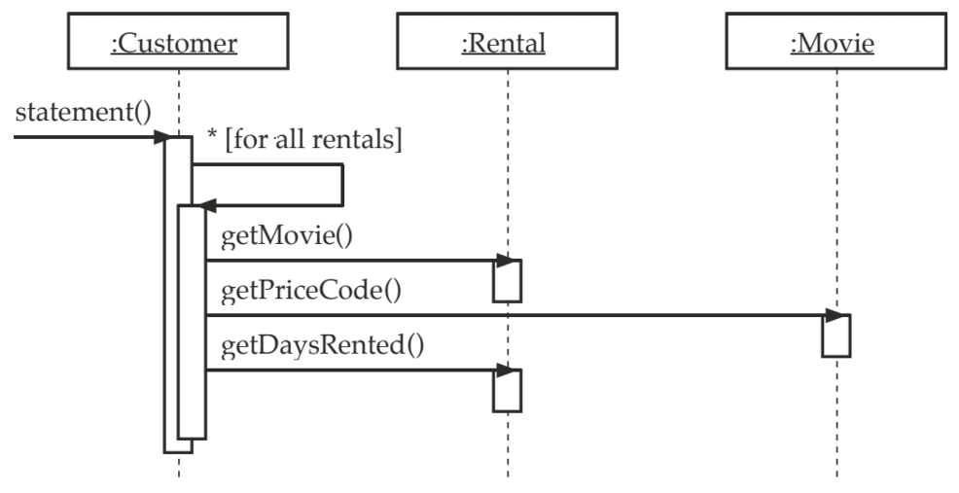
Initial Behavioral Design

Slide 51
Code Smells
What smells?

Slide 52
Code Smells
Issues:
  Procedural, not object-oriented programming
  statement() method does too much
  Customer class is a blob class
  Potentially difficult to add features
    E.g., HTML output
    E.g., new charging rules
Notes:
incurring technical debt

Slide 53
Refactoring
Idea:
  If the code is not structured conveniently to add a feature, first refactor the program to make it easy to add the feature, then add the feature
  We will make changes in small steps
  Do test-driven development
    Before each change we should make and run unit tests
    Make the small change
    Then test again

Slide 54
Refactoring
Goal:
  Decompose statement() method
  We will do these by extracting logical chunks of code as a new methods

Slide 55
Refactoring Roadmap
Too much code in statement()
  First, we will extract the code that determines movie costs as a new method
  Next, we will move the extracted method to Rental class
    2.5: Plus, we will update temporary variable usage
  Then, we will extract the code that calculates frequent renter reward points as a new method in the Rental class
  Finally, we will extract temporary variable usage as new methods

Slide 56
1. Extract Movie Costs Code
First step before extracting the code:
  Make and run unit tests
Notes:
assume this

Slide 57
1. Extract Movie Costs Code
when (rental.movie.priceCode) {
Movie.REGULAR -> {
thisAmount += 2.0
}
Movie.NEW_RELEASE -> {
thisAmount += rental.daysRented * 3.0
}
Movie.CHILDRENS -> {
thisAmount += 1.5
}
}
…
thisAmount = amountFor(rental)

Slide 58
1. Extract Movie Costs Code
when (rental.movie.priceCode) {
Movie.REGULAR -> {
thisAmount += 2.0
}
Movie.NEW_RELEASE -> {
thisAmount += rental.daysRented * 3.0
}
Movie.CHILDRENS -> {
thisAmount += 1.5
}
}
…
thisAmount = amountFor(rental)
We will take this code
And put it in this function we will define

Slide 59
1. Extract Movie Costs Code
class Customer(val name: String) {
…
private fun amountFor(rental: Rental) {
var thisAmount = 0.0
when (rental.movie.priceCode) {
Movie.REGULAR -> {
thisAmount += 2.0
}
Movie.NEW_RELEASE -> {
thisAmount += rental.daysRented * 3.0
}
Movie.CHILDRENS -> {
thisAmount += 1.5
}
}
return thisAmount
}
The code to determine the movie
cost is now taken out of the large method and defined as a new method

Slide 60
1. Extract Movie Costs Code
After extracting, we compile and test
  Remember, make small steps and test often!

Slide 61
2. Move amountFor() Method
Refactoring:
  Move amountFor() to Rental class
    Method uses rental information, but not customer information
  Move this method to the right class

Slide 62
2. Move amountFor() Method (Before)
class Customer(val name: String) {
…
private fun amountFor(rental: Rental) {
var thisAmount = 0.0
when (rental.movie.priceCode) {
Movie.REGULAR -> {
thisAmount += 2.0
}
Movie.NEW_RELEASE -> {
thisAmount += rental.daysRented * 3.0
}
Movie.CHILDRENS -> {
thisAmount += 1.5
}
}
return thisAmount
}

Slide 63
2. Move amountFor() Method (Before)
class Customer(val name: String) {
…
private fun amountFor(rental: Rental) {
var thisAmount = 0.0
when (rental.movie.priceCode) {
Movie.REGULAR -> {
thisAmount += 2.0
}
Movie.NEW_RELEASE -> {
thisAmount += rental.daysRented * 3.0
}
Movie.CHILDRENS -> {
thisAmount += 1.5
}
}
return thisAmount
}
Feature envy! Customer class just
using data from rental class
Code in orange will be naming changes for better readability when we move the method to the Rental class

Slide 64
2. Move amountFor() Method (After)
class Rental(val movie: Movie, val daysRented: Int){
…
fun getCharge() {
var result = 0.0
when (movie.priceCode) {
Movie.REGULAR -> {
result += 2.0
}
Movie.NEW_RELEASE -> {
result += daysRented * 3.0
}
Movie.CHILDRENS -> {
result += 1.5
}
}
return result
}

Slide 65
2. Move amountFor() Method (After)
class Customer(val name: String){
…
private fun amountFor(rental: Rental) {
return rental.getCharge();
}
…
}
For now, we update amountFor() in the Customer class.
However, we will update usage in statement() to use rental.getCharge()
instead, and eventually remove amountFor().

Slide 66
2. Move amountFor() Method (Cleaning Up)
Again, compile and test
Then, we will clean up the indirection
  Customer class still using amountFor(), which just calls rental.getCharge()
  We can just call rental.getCharge() directly instead
  Then, we can remove amountFor()

Slide 67
2. Move amountFor() Method (Cleaning Up)
fun statement() {
…
for (rental in rentals) {
thisAmount = amountFor(rental)
…
}

Slide 68
2. Move amountFor() Method (Cleaning Up)
fun statement() {
…
for (rental in rentals) {
thisAmount = rental.getCharge()
…
}

Slide 69
2. Move amountFor() Method (Cleaning Up)
Once again, compile and test

Slide 70
2. Move amountFor() Method (Cleaning Up)
Refactoring:
  Eliminate thisAmount temporary in statement()
  Replace redundant temporary variable with query

Slide 71
2.5 Update Temp Variable Usage (Before)
class Customer(val name: String){
…
class statement(): String {
…
for (rental in rentals){
var thisAmount = 0
thisAmount = rental.getCharge()
// add frequent renter points
frequentRenterPoints++;
// add bonus for a two day new release rental
if ((rental.movie.priceCode == Movie.NEW_RELEASE) &&
rental.daysRented() > 1){ frequentRenterPoints++ }
// show figures for this rental
result.append(“\t{rental.movie.title}\t$thisAmount\n”)
totalAmount += thisAmount
}
…

Slide 72
2.5 Update Temp Variable Usage (After)
class Customer(val name: String){
…
class statement(): String {
…
for (rental in rentals){
// add frequent renter points
frequentRenterPoints++;
// add bonus for a two day new release rental
if ((rental.movie.priceCode == Movie.NEW_RELEASE) &&
rental.daysRented() > 1){ frequentRenterPoints++ }
// show figures for this rental
val amount = rental.getCharge()
result.append(“\t{rental.movie.title}\t$amount\n”)
totalAmount += amount
}
…

Slide 73
3. Extract Renter Points Code
Refactoring:
  Similar to what we did with the movie costs code, extract frequent renter reward points logic from statement()
    Applicable rules go with the Rental class, not Customer
  We will continue to write and run unit tests as we make these changes (though it will not be explicitly stated)

Slide 74
3. Extract Renter Points Code (Before)
class Customer(val name: String){
…
class statement(): String {
…
for (rental in rentals){
// add frequent renter points
frequentRenterPoints++;
// add bonus for a two day new release rental
if ((rental.movie.priceCode == Movie.NEW_RELEASE) &&
rental.daysRented() > 1){ frequentRenterPoints++ }
// show figures for this rental
val amount = rental.getCharge()
result.append(“\t{rental.movie.title}\t$amount\n”)
totalAmount += amount
}
…

Slide 75
3. Extract Renter Points Code (After)
class Customer(val name: String){
…
class statement(): String {
…
for (rental in rentals){
// add frequent renter points
frequentRenterPoints += rental.getFrequentRenterPoints()
// show figures for this rental
val amount = rental.getCharge()
result.append(“\t{rental.movie.title}\t$amount\n”)
totalAmount += amount
}
…
We will move the code into
this function we will define

Slide 76
3. Extract Renter Points Code (After)
class Rental(val movie: Movie, val daysRented: Int) {
…
fun getFrequentRenterPoints(): Int {
return if (movie.priceCode == Movie.NEW_RELEASE && daysRented > 1) 2 else 1
}
}
We define the method in the Rental class directly,
since we already updated the code in the Customer class
to use this method
The logic in the method is a condensed if else statement

Slide 77
4. Replace Temp with Query 1
Refactoring:
  Eliminate the temporary variable totalAmount and replace with getTotalCharge() query

Slide 78
4. Replace Temp with Query 1 (Before)
class Customer(val name: String){
…
class statement(): String {
var totalAmount = 0.0;
var frequentRenterPoints = 0;
var result = StringBuilder()
result.append(“Rental Record for $name\n”)
for (rental in rentals){
// add frequent renter points
frequentRenterPoints += rental.getFrequentRenterPoints
// show figures for this rental
val amount = rental.getCharge()
result.append(“\t{rental.movie.title}\t$amount\n”)
totalAmount += amount
}
// add footer lines
result.append(“Amount owed is $totalAmount\n”)
result.append(“You earned $frequentRenterPoints frequent renter points”)
return result.toString()
}
}

Slide 79
4. Replace Temp with Query 1 (After)
class Customer(val name: String){
…
class statement(): String {
var frequentRenterPoints = 0;
var result = StringBuilder()
result.append(“Rental Record for $name\n”)
for (rental in rentals){
// add frequent renter points
frequentRenterPoints += rental.getFrequentRenterPoints
// show figures for this rental
val amount = rental.getCharge()
result.append(“\t{rental.movie.title}\t$amount\n”)
}
// add footer lines
result.append(“Amount owed is ${getTotalCharge()}\n”)
result.append(“You earned $frequentRenterPoints frequent renter points”)
return result.toString()
}
}

Slide 80
4. Replace Temp with Query 1 (After)
class Customer(val name: String){
…
private fun getTotalCharge(): Double {
var result = 0.0;
for (rental in rentals) {
result += rental.getCharge()
}
return result
}
…
}
We make a private function that calculates total charge that statement() can use

Slide 81
4. Replace Temp with Query 2
Refactoring:
  Eliminate frequentRenterPoints temporary and replace with getTotalFrequentRenterPoints() query

Slide 82
4. Replace Temp with Query 2 (Before)
class Customer(val name: String){
…
class statement(): String {
var frequentRenterPoints = 0;
var result = StringBuilder()
result.append(“Rental Record for $name\n”)
for (rental in rentals){
// add frequent renter points
frequentRenterPoints += rental.getFrequentRenterPoints
// show figures for this rental
val amount = rental.getCharge()
result.append(“\t{rental.movie.title}\t$amount\n”)
}
// add footer lines
result.append(“Amount owed is ${getTotalCharge()}\n”)
result.append(“You earned $frequentRenterPoints frequent renter points”)
return result.toString()
}
}

Slide 83
4. Replace Temp with Query 2 (After)
class Customer(val name: String){
…
class statement(): String {
var result = StringBuilder()
result.append(“Rental Record for $name\n”)
for (rental in rentals){
// show figures for this rental
val amount = rental.getCharge()
result.append(“\t{rental.movie.title}\t$amount\n”)
}
// add footer lines
result.append(“Amount owed is ${getTotalCharge()}\n”)
result.append(“You earned ${getTotalFrequentRenterPoints()} frequent renter points”)
return result.toString()
}
}

Slide 84
4. Replace Temp with Query 2 (After)
class Customer(val name: String){
…
private getTotalFrequentRenterPoints(): Int {
Var result = 0;
for (rental in rentals) {
result += rental.getFrequentRenterPoints()
}
return result;
}
…
}
Similarly, we make another private function that calculates total renter points that statement() can use

Slide 85
Initial Structural Design
Customer
0..*
Rental
+statement(): String
…
+getDaysRented(): int
…
0..*
1
Movie
+getPriceCode(): int
…

Slide 86
After Extracting Movie Costs Code
Customer
0..*
Rental
+statement(): String
–amountFor( Rental ): double
…
+getDaysRented(): int
…
0..*
1
Movie
+getPriceCode(): int
…

Slide 87
During Moving amountFor() Method
Customer
0..*
Rental
+statement(): String
–amountFor( Rental ): double
…
+getDaysRented(): int
+getCharge(): double
…
0..*
1
Movie
+getPriceCode(): int
…

Slide 88
After Moving amountFor() Method
Customer
0..*
Rental
+statement(): String
…
+getDaysRented(): int
+getCharge(): double
…
0..*
amountFor() removed
1
Movie
+getPriceCode(): int
…

Slide 89
After Extracting and Moving Renter Points Code
Customer
0..*
Rental
+statement(): String
…
+getDaysRented(): int
+getCharge(): double
+getFrequentRenterPoints(): int
…
0..*
1
Movie
+getPriceCode(): int
…

Slide 90
After Replacing Temp with Query 1
Customer
0..*
Rental
+statement(): String
–getTotalCharge(): double
…
+getDaysRented(): int
+getCharge(): double
+getFrequentRenterPoints(): int
…
0..*
1
Movie
+getPriceCode(): int
…

Slide 91
After Replacing Temp with Query 2
Customer
0..*
Rental
+statement(): String
–getTotalCharge(): double
–getTotalFrequentRenterPoints(): int
…
+getDaysRented(): int
+getCharge(): double
+getFrequentRenterPoints(): int
…
0..*
1
Movie
+getPriceCode(): int
…

Slide 92
Initial Refactor Structural Design
Customer
0..*
Rental
+statement(): String
–getTotalCharge(): double
–getTotalFrequentRenterPoints(): int
…
+getDaysRented(): int
+getCharge(): double
+getFrequentRenterPoints(): int
…
0..*
1
Movie
+getPriceCode(): int
…

Slide 93
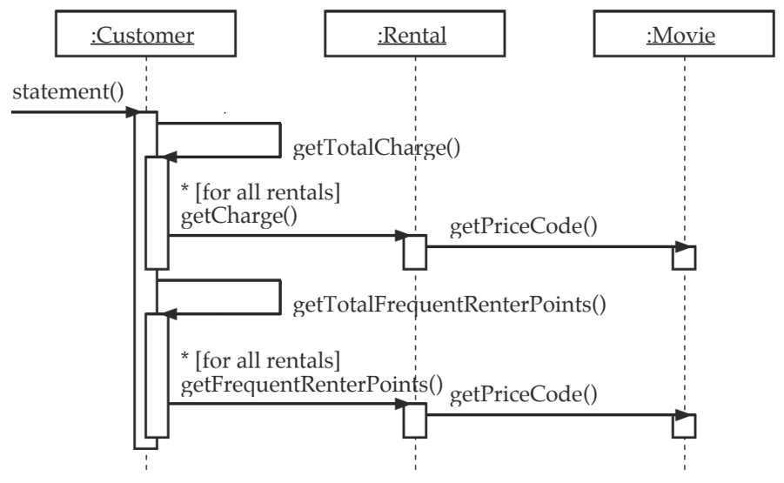
Initial Refactor Behavioral Design

Slide 94
Refactoring
Consequences:
  More object-oriented
    Decomposes big methods into smaller ones
    Distributes responsibilities among classes
    Easier to add new features
      E.g., HTML output
      E.g., new charging rules
  More code
  Slower performance?

Slide 95
Discussion: More Refactoring?
How could we further improve the code?

Slide 96
Discussion: More Refactoring?
How could we further improve the code?
  Movie types and prices could change in the future, so:
    Rental logic should not depend on specific movie types
    Price parent class can be made to make it easier to manage price behavior
      Relationship with Movie class: Movie has a Price

Slide 97
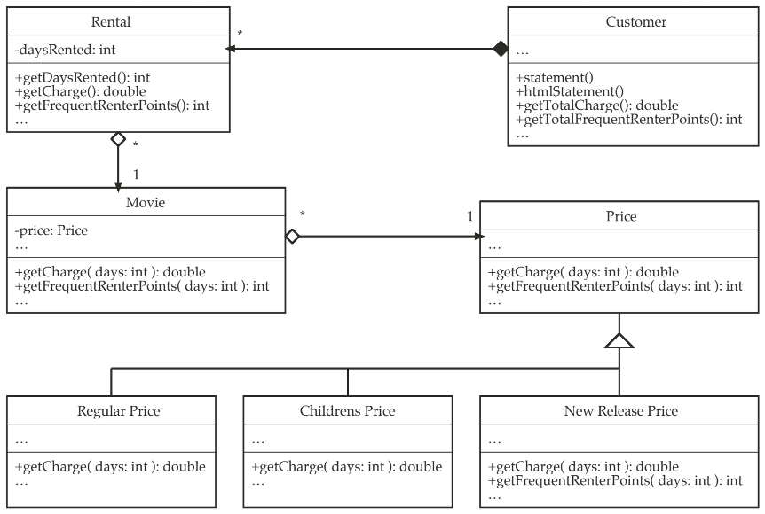
Example Structure Design After Further Refactoring

Slide 98
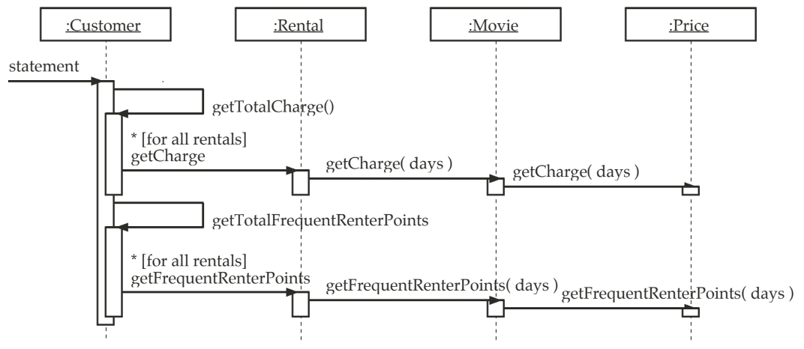
Example Behavioral Design After Further Refactoring

Slide 99
More Information
Books:
  Refactoring
    M. Fowler
    Addison-Wesley, 1999
  AntiPatterns
    W.J. Brown, R. C. Malveau, H. W. McCormick III,
    T.J. Mowbray
    Wiley, 1998
  Practical Java
    P. Haggar
    Addison-Wesley, 2000

Slide 100
More Information
Books:
  Effective Java
    J. Bloch
    Addison-Wesley, 2001

Slide 101
More Information
Articles:
  “Cloning Considered Harmful” Considered Harmful
    C. Kapser and M. W. Godfrey
    WCRE 2006 Proceedings, IEEE CS Press

Slide 102
More Information
Links:
  Refactoring Home Page
    https://refactoring.com/

